Slide 1
Human Computer Interaction Project
Topic : Emotion Analysis and Response
Team : Bhargavi Gummanur
Sahil Sagar
Devesh
Romaanchan Skanda

Slide 2
Problem Statement
Emotional Support System for People in Need

Slide 3
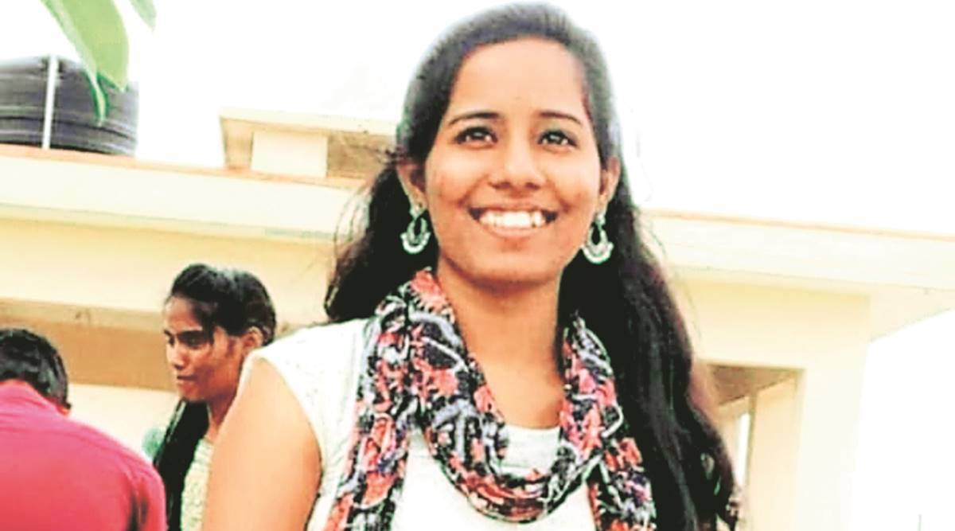
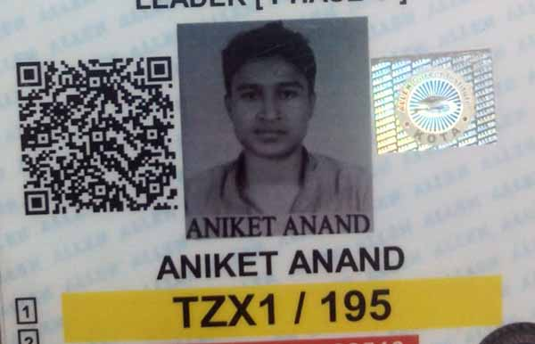
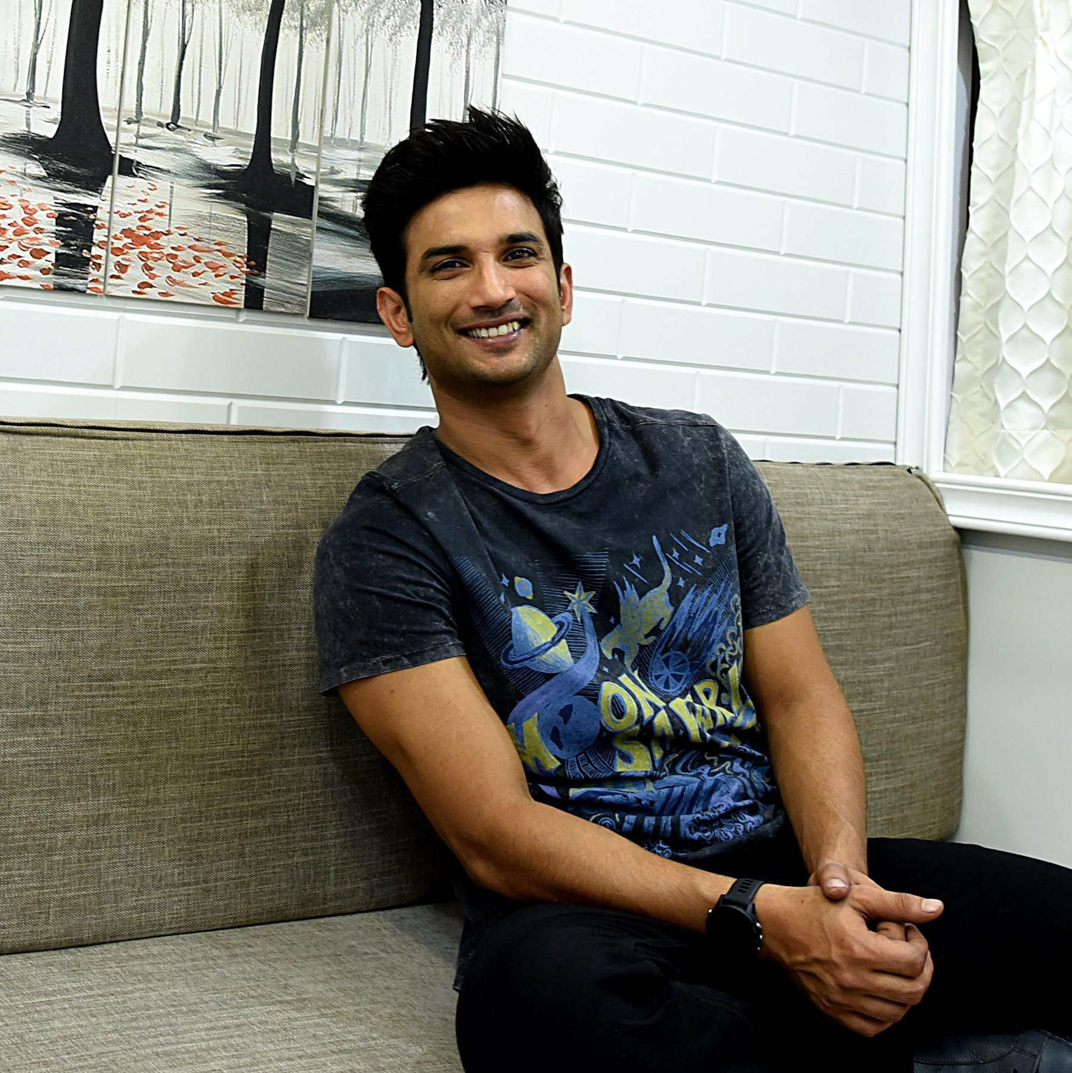
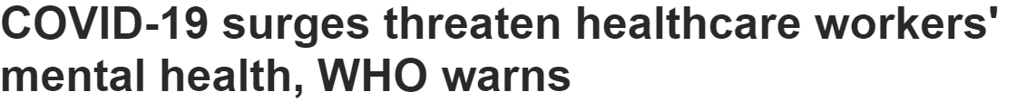

Slide 4
Need Finding

Slide 5
The World Health Organization defines mental health as:
“a state of well-being in which the individual realizes his or her own abilities, can cope with the normal stresses of life, can work productively and fruitfully, and is able to make a contribution to his or her community"
According to the National Institute of Mental Health in the United States,one in every five US adult lives with a mental illness.
The aforementioned WHO also states that:
Around 1 in 5 of the world's children and adolescents have a mental disorder.
About half of mental disorders begin before the age of 14.

Slide 6
Almost 800 000 people die by suicide every year; 1 person dies from suicide every 40 seconds. Suicide is the second leading cause of death in individuals aged 15-29 years.
The global economy loses about US$ 1 trillion per year in productivity due to depression and anxiety.
Now these are just the global numbers,mental health is still considered a taboo in India and there is a lot of stigma attached to it.

Slide 7
WHO states that in India, (per 100,000 population) there are psychiatrists (0.3), nurses (0.12), psychologists (0.07) and social workers (0.07), while the desirable number is anything above 3 psychiatrists and psychologists per 100,000 population.
According to a study mental health literacy in adolescents was found be very low.Depression was identified by 29.04% and schizophrenia/psychosis was recognized only by 1.31%. Stigma was noted to be present in help-seeking.
This lack of infrastructure and awareness combined with the increase in mental illness due to the whole COVID scenario makes our platform the need of the hour.

Slide 8
Interview Experience

Slide 9
Questions Asked during the Interview
What are your thoughts on Mental Health? How important do you think it is?
How often do you come across people with chronic anxiety or depression?
Do you personally know of people who have gone down this road?
How do you think people are suppose to react to these circumstances?
How do you think people react to these circumstances?
What do you think are some of the best ways to make the mental health of a person better?

Slide 10
Usefulness of the Project
Our website aims to bridge the gap between the existing need and the present supply of the mental health help
The goal is to raise awareness and at the same time support those in need of help by providing a link to the best in class healthcare infrastructure and work towards the goal of a more healthy and productive India.

Slide 11
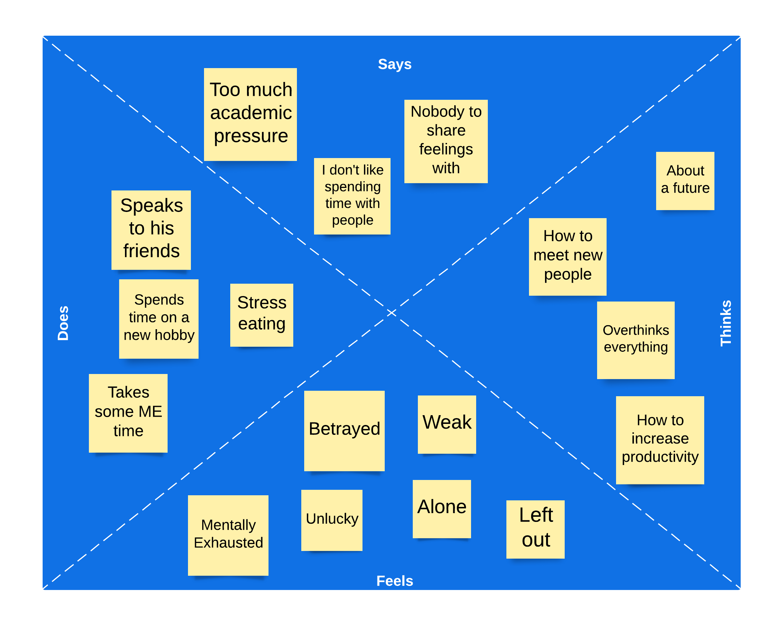
Empathy Map

Slide 12
Low Fidelity Prototype

Slide 13
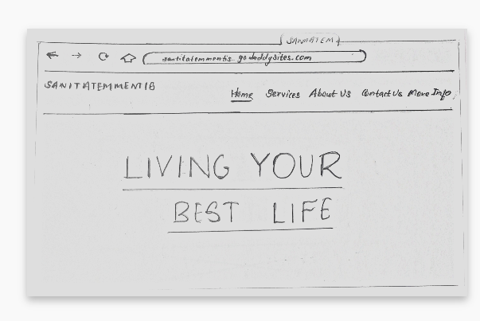
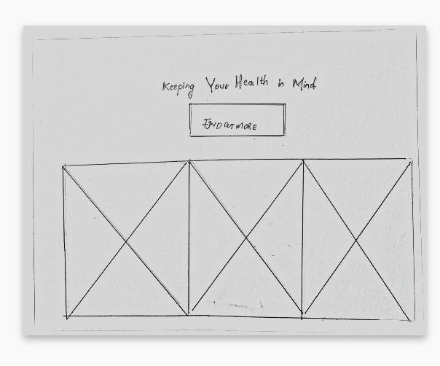
Home Page
The home page is a brief introduction to our website with links to services, About Us,Contact Us and More Info on the navigation bar. The ‘Find out more’ icon on the bottom half of the home page redirects to the ‘More_Info’ page in case the user wants to explore more on the most common mental health issues. The ‘X’ in the second image indicates content.

Slide 14
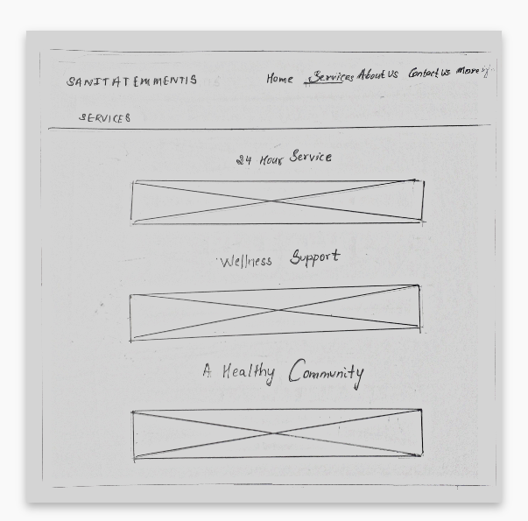
Services
This section gives information on the different services provided. We have narrowed it down to three important services that is 24 hour service, constant support from the team no matter what the issue and a chance to be a part of a larger community to build a network of people working together.

Slide 15
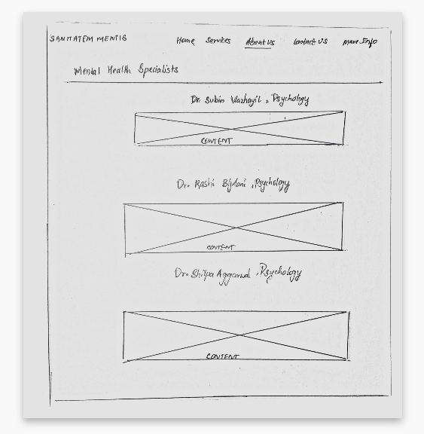
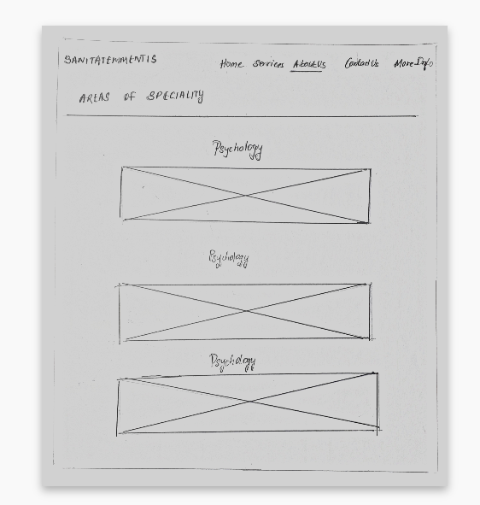
List of Doctors
Here we introduce the team to the user. Though a large team is involved, we have included three team members along with their areas of speciality and their relevant contributions to the field of mental health.

Slide 16
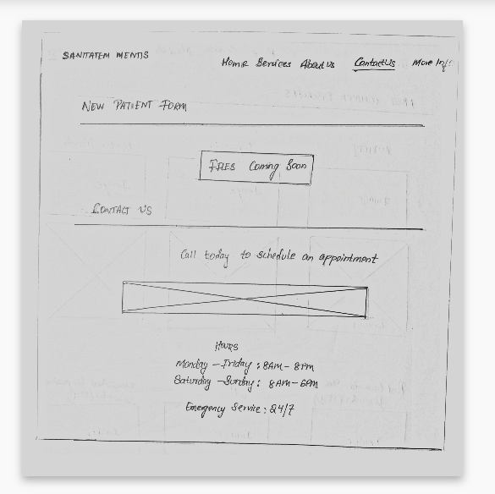
Contact Us
The Contact Us page gives the users the opportunity to interact with the team members. The users are required to fill out the contact form to book an appointment or session with one of the team members. The timings for weekdays and weekends are given at the bottom of the page.

Slide 17
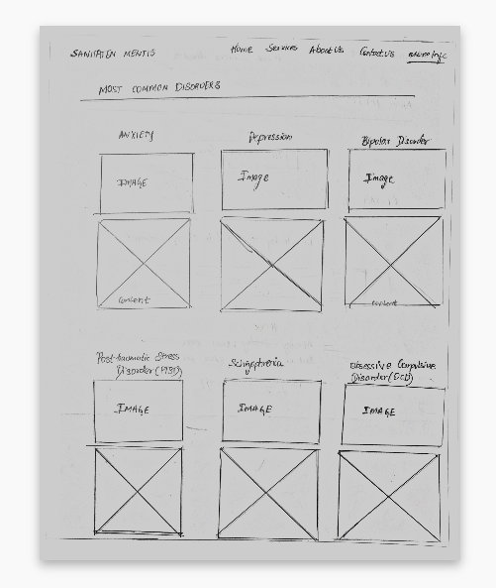
Most Common Mental Issues
This page is purely meant for educational purposes which gives insights on some of the most common mental health disorders experienced by many individuals. We included brief explanations of 6 conditions being Anxiety, Depression, Bipolar Disorder, PTSD, Schizophrenia and Obsessive Compulsive Disorder(OCD).

Slide 18
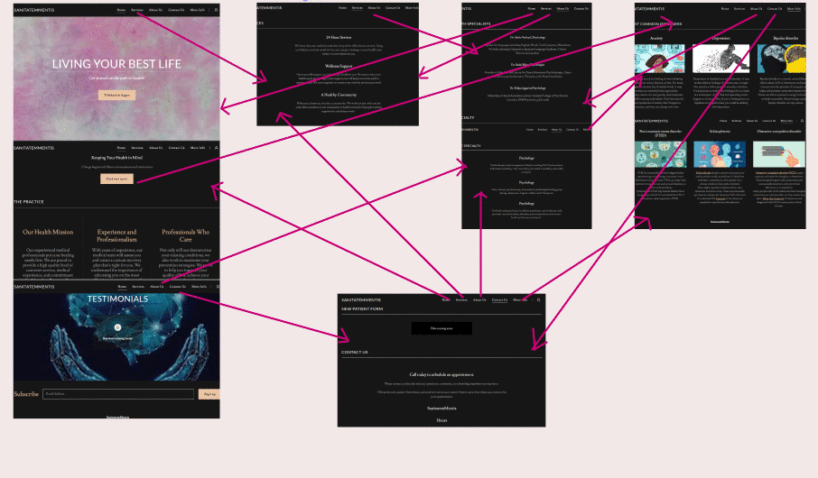
High Fidelity Prototype

Slide 19
Heuristic Evaluation

Slide 20
Aesthetic and Minimalist Design
The UI to create accounts, confess to your problems and to seek help have been orchestrated in such a way that anyone with the basic computer knowledge can find doctors and other people to interact with and obtain solutions as to how they can handle the current situations and improve their mental health.
This helps in better usability cases for the website and shows its merit in handling all the important situations.

Slide 21
Help users recognize, diagnose and recover from errors
The implementation is done as a website and hence all the actions are reversible as pressing back on the web browsers will result in you going back to the previous page undoing everything you have done in the previous page. This helps in undoing specific actions done by the user.
The website also clearly shows any errors done by them in giving input to the necessary doctor or if they are contacting the right doctor or not.

Slide 22
Flexibility and efficiency of use
This rule evaluates how well our system caters to experienced users and inexperienced users(first time). First time users must fill in the form provided in the Contact Us page of the website to book an appointment with one of the team members. He/She is required to enter relevant information that is sufficient to identify the user. The user is given the liberty to choose among the professionals if he/she is a first time user. If not, the user can just enter his/her phone number or email and appointment time. We keep track of the users and their appointment details with their specialists.

Slide 23
Reduce Short Term Memory Load
Each page in our website clearly describes its’ presence in the website and the user would not face any difficulty while browsing through each tab. The Home page gives a brief introduction to what our website focuses on. The user can navigate to the Services page to read through the services provided by us . About Us gives the team information with their Areas of Specialty. Contact Us allows the user to book appointments and gives the working hours on weekdays and weekends. More_Info gives a brief introduction to six common mental health issues faced. This page is for educational purposes in case the user is just browsing though to find information on mental health disorders.

Slide 24
Enable the usage of shortcuts
The website has shortcuts at the end of each page. These shortcuts contain the most likely and frequently visited parts of the website. This will help in easier and faster navigation. The ability to bookmark the website also helps not only by saving the right website but also in faster access of the website from the web.
Overall the website is optimized for easier and faster access for people who are in need of any kind of mental support.

Slide 25
Strive For Consistency
The chatbot icon, buttons linking to different web pages in the website are not bound to be confusing for the user. Each page has a navigation bar therefore every page can be accessed. The Contact Form is easily understandable and visually non problematic to the user. Each section is clearly explained and the connections between each web page are consistent , therefore do not result in unexpected outcomes.

Slide 26
User Control and Freedom
The User has complete control over his actions. He can choose as to what kind of doctor he wishes to contact and which doctor to be specific. The website has shortcuts for faster and easier redirection.
The website also offers a feature to tell how the user is feeling as of now to determine the types of doctor to which the user can be recommended.

Slide 27
Recognition rather than recall
Every single necessary detail once stored by the user onto the website is saved and is remembered. The user does not have to remember these details every time he/she uses the website. Even the login details need not be remembered as once the person logins from a particular device will stay logged in.
This way even between actions the data is automatically transferred and these are saved and are passed between doctors when the patient requests a change in doctors.

Slide 28
THANK YOU

